Slide 1
ASP.NET INTRINSIC OBJECTS
Trường Đại học Quy Nhơn
Khoa Công nghệ thông tin – Bộ môn Công nghệ phần mềm
CHƯƠNG 4: PHÁT TRIỂN ỨNG DỤNG WEB VỚI ASP.NET
THS. VŨ SƠN LÂM

Slide 2
ASP.NET INTRINSIC OBJECTS
ASP.NET intrinsic objects (Core objects, Built-in objects) includes:
Request
Response
Server
Application
Session
REF: https://msdn.microsoft.com/en-us/library/x6w6xys5(v=vs.71).aspx

Slide 3
ASP.NET INTRINSIC OBJECTS
ASP.NET intrinsic objects (Core objects, Built-in objects) includes:
Request
Response
Server
Application
Session
REF: https://msdn.microsoft.com/en-us/library/x6w6xys5(v=vs.71).aspx

Slide 4
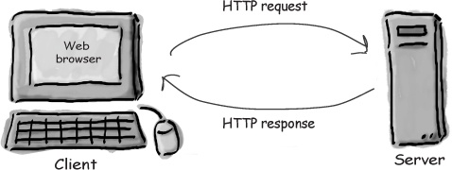
REQUEST OBJECT
The Server is always passive in a client-server environment.
When the client sends a request for a URL, at this time the server traps the data sent by the client with help of the Request object and responds by sending the requested page to the client’s browser
Notes:
Passive nghĩa bị động.
Ví dụ: Anh A yêu chị B, mà anh A bị động, nghĩa là cứ đợi khi nào chị B rủ đi chơi thì đi, không thì thôi.
Chẳng hạn chị B gửi một request: anh ơi, đi xem phim nhé, anh B respone, OK.

Slide 5
REQUEST OBJECT
The Request object provides the developer all the information about the user’s request.
Any information sent by the browser to the server can be retrieved by Request object.
Important collections in Request object:
QueryString
Form
ServerVariables
All values in properties of Request object are read-only.

Slide 6
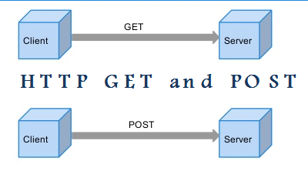
REQUEST OBJECT
There are basically two ways that the browser can send specific information to the server:
By GET method → data in Request.QueryString collection
By POST method → data in Request.Form collection
GET
REQUEST
POST

Slide 7
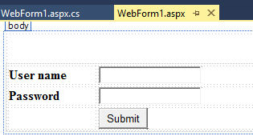
QUERYSTRING COLLECTION
Design a form
Change form’s method to GET (default is POST)
<form id="form1" runat="server" method="get">

Slide 8
QUERYSTRING COLLECTION
In Click event of Submit button, we get information from QueryString collection.
protected void btnSubmit_Click(object sender, EventArgs e)
{
String userName = Request.QueryString["txtUserName"];
String Password = Request.QueryString["txtPassword"];
Response.Write(userName + "<br/>" + Password);
}

Slide 9
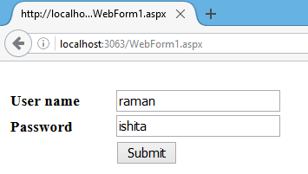
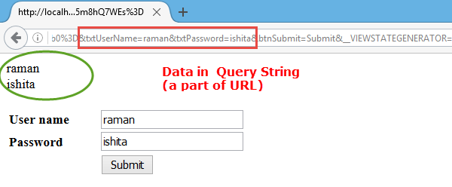

Slide 10
FORM COLLECTION
The second way for sending information from Client to Server is POST method.
Use method = “post” instead of “get”
Using POST method, the information inside the HTTP message body rather than adding it to the URL as a query string
<form id="form1" runat="server" method="post">
Equivalent (Because POST is a default method)
<form id="form1" runat="server">

Slide 11
FORM COLLECTION
In Click event of Submit button, we get information from Form collection.
protected void btnSubmit_Click(object sender, EventArgs e)
{
String userName = Request.Form["txtUserName"];
String Password = Request.Form["txtPassword"];
Response.Write(userName + "<br/>" + Password);
}

Slide 12
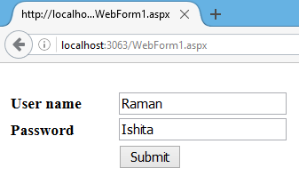
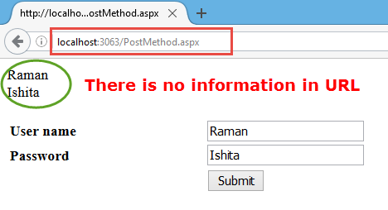

Slide 13
SERVERVARIABLES
The ServerVariables collection retrieves the values of:
Request method: POST or GET
Visitor's browser type: Chrome, Firefox…
Visitor’s IP address
Server name, Server port: e.g., localhost:8080
Server software: e.g., Microsoft IIS/8.0
Physical path: where the web is stored on server’s disk

Slide 14
SERVERVARIABLES COLLECTION
If we want to know which method was used to send information from Client to Server:
The browser’s type:
The visitor's IP address:
Request.ServerVariables["REQUEST_METHOD"];
Request.ServerVariables["HTTP_USER_AGENT"];
Request.ServerVariables["REMOTE_ADDR"];

Slide 15
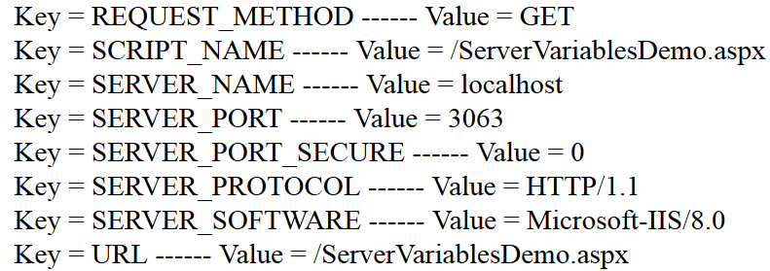
PRINT ALL VALUES IN SERVERVARIABLES
foreach (String x in Request.ServerVariables) {
Response.Write("Key = " + x +
" ------ Value = " +
Request.ServerVariables[x] + "<br>");
}

Slide 16
ASP.NET INTRINSIC OBJECTS
ASP.NET intrinsic objects (Core objects, Built-in objects) includes:
Request
Response
Server
Application
Session
REF: https://msdn.microsoft.com/en-us/library/x6w6xys5(v=vs.71).aspx

Slide 17
RESPONSE OBJECT
Response object is used to send information to client.
Response have only one collection: COOKIES
Some useful methods of Response object:
Write: write a string to HTTP response output stream that the browser receives.
Redirect: redirect user to other web page. E.g., redirect to Login page when a guest hits on Checkout button

Slide 18
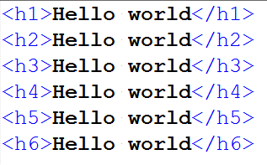
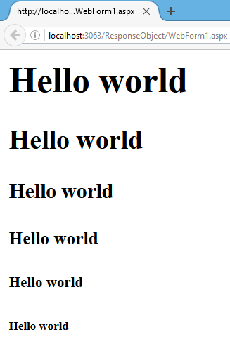
protected void Page_Load(object sender, EventArgs e){
for (int i = 1; i <= 6; i++){
Response.Write(
string.Format("<h{0}>{1}</h{0}>", i, "Hello world"));
}
}
An example of Response’s Write method

Slide 19
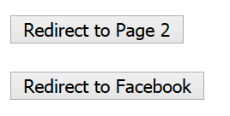
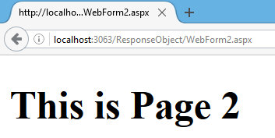
An example of Response’s Redirect method
protected void Button1_Click(object sender, EventArgs e)
{
Response.Redirect("~/ResponseObject/WebForm2.aspx");
}
protected void Button2_Click(object sender, EventArgs e)
{
Response.Redirect("http://facebook.com");
}

Slide 20

COOKIE
Cookie is a file used to store data on the client’s system
Cookies were originally developed in 1995 by the Netscape Communications Corporation
The word 'cookie' comes from 'magic cookie,' a term in programming languages for a piece of information shared between co-operating pieces of software
The American tradition of giving and sharing edible cookies
REF: http://www.aboutcookies.org/

Slide 21
COOKIE
A cookie is a packet of information sent by browser to the server with each request.
It can be used to store information that is available the next time browser starts.
Data in Cookie can be:
Written by using Response object.
Read through Request object.
Data will persist till the clear of Cookie (by Browser)

Slide 22
PURPOSE OF COOKIE
Cookies make the interaction between users and web sites faster and easier:
Remember registration detail
Fill up a shopping cart
…
Cookies enable web sites to monitor their users' web surfing habits and profile them for marketing purposes:
For example, to find out which products or services they are interested in and send them targeted advertisements

Slide 23

A CASE STUDY OF USING COOKIE
Access www.ebay.com but do not sign in.
Try to add some products to cart.
Exiting the website (or even shutdown your computer)
Access again www.ebay.com
You will see all products which you have added them in your cart.
→ Ebay used Cookie to store information on your computer.
Go to another computer, and accees to ebay site → there is nothing in your cart

Slide 24
CREATE AND GET VALUE FROM COOKIE
Create a Cookie
Get value from Cookie
String key = "LastVisitedOn";
String value = DateTime.Now.ToString();
Response.Cookies.Add(new HttpCookie(key,value));
Request.Cookies["LastVisitedOn"]

Slide 25

DELETE A COOKIE
We cannot directly delete a cookie on a user's computer (Because it is on user’s computer)
However, we can direct the user's browser to delete the cookie by setting the cookie's expiration date to a past date.
How to delete Cookie on Server-side ?

Slide 26
DELETE A COOKIE
Steps to delete Cookie:
Determine whether the cookie exists, and if so, create a new cookie with the same name.
Set the cookie's expiration date to a time in the past.
Add the cookie to the Cookies collection object.
if(Request.Cookies["LastVisitedOn"] != null)
{
HttpCookie cookie= new HttpCookie("LastVisitedOn");
cookie.Expires = DateTime.Now.AddDays(-1d);
Response.Cookies.Add(cookie);
}

Slide 27
protected void Page_Load(object sender, EventArgs e)
{
if (Request.Cookies["LastVisitedOn"] != null) {
Response.Write("Welcome you come back <br>");
Response.Write("Last visited on:" +
Request.Cookies["LastVisitedOn"].Value );
}
else {
Response.Write(
"This is the first time you visit us");
}
String key = "LastVisitedOn";
String value = DateTime.Now.ToString();
Response.Cookies.Add(new HttpCookie(key,value));
}

Slide 28
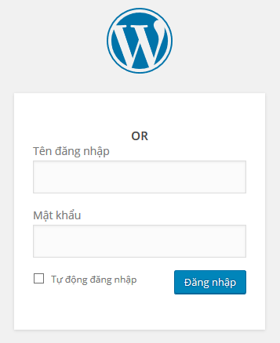
EXERCISE - COOKIE
Cài đặt chức năng “Tự động đăng nhập” (Remembe me)
Nếu người dùng chọn “Tự động đăng nhập”
→ Lưu username/password vào Cookie
Lần sau người dùng truy cập vào website
→ Tự động load thông tin đăng nhập trong Cookie, và thực hiện kiểm tra đăng nhập

Slide 29
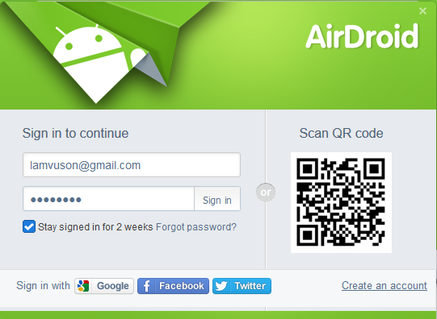
EXERCISE 2 - COOKIE
Implement “Stay signed in for 2 weeks” function

Slide 30
SESSION OBJECT
A session is said to begin when a user access to a site and finishes when he close the site.
Data in Session object will persist till the close of the browser.
Data in Session object are key/value pairs
Session["username"] = txtUserName.Text;
Key
Value

Slide 31
SESSION OBJECT
Session can be used to share information between pages in a site
Page 1
Page 2
Page 3
Pages in a site:
www.example.com
Session object

Slide 32

EXAMPLE – SESSION OBJECT
Create 2 pages: WebForm1.aspx and WebForm2.aspx
In WebForm1, create a textbox and a button:

Slide 33
EXAMPLE – SESSION OBJECT
Write Click event for the button:
Store ‘username’ information in session object
Redirect to page 2
protected void Button1_Click(object sender, EventArgs e)
{
Session["username"] = txtUserName.Text;
Response.Redirect("~/SessionDemo/WebForm2.aspx");
}

Slide 34
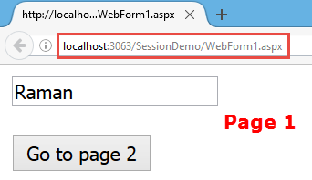
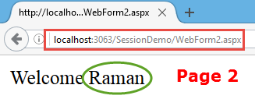
EXAMPLE – SESSION OBJECT
In WebForm2, get value of ‘username’ from Session
protected void Page_Load(object sender, EventArgs e){
String userName = Session["username"].ToString();
Response.Write("Welcome " + userName);
}

Slide 35
APPLICATION OBJECT
Application object is also used to maintain state in the web.
Variables stored in Application object are available till the down of web server.
When we should use Application-level variables?
When we need a variable that:
Can be accessed in all pages of the website
Can be accessed by all users
Persist along with web server life

Slide 36


Application variable is visible to all the users
while …
Each user has a separated Session variable
Application object

Slide 37
APPLICATION OBJECT
Declaring an Application variable is very simple:
This code declares a variable named “HitCounter”.
Ideal place for declaration of such variable is global.asax file in the Application_onStart event.
Application["HitsCounter"] = 0;

Slide 38
APPLICATION OBJECT
Updating an Application variable
Application.Lock();
Application[“HitsCounter"] =
int.Parse(Application["HitsCounter"].ToString()) + 1;
Application.UnLock();

Slide 39
GLOBAL.ASAX
The Global.asax file, also known as the ASP.NET application file, is a file that contains code for responding to application-level events raised by ASP.NET.
This file resides in the root directory of an ASP.NET-based application.

Slide 40
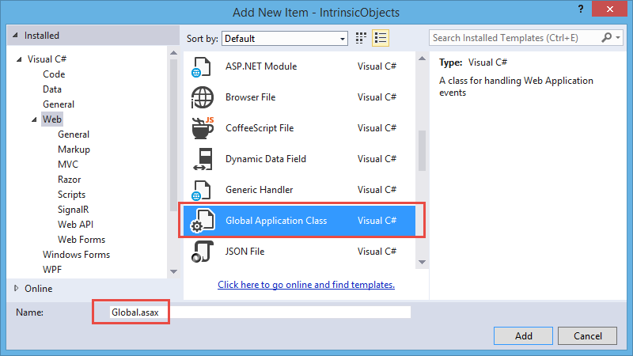
ADDING A GLOBAL.ASAX FILE

Slide 41
A Global.asax file looks like this
public class Global : System.Web.HttpApplication
{
protected void Application_Start(object sender, EventArgs e){
}
protected void Session_Start(object sender, EventArgs e){
}
protected void Application_BeginRequest(object sender, EventArgs e){
}
protected void Application_AuthenticateRequest(object sender, EventArgs e){
}
protected void Application_Error(object sender, EventArgs e){
}
protected void Session_End(object sender, EventArgs e){
}
protected void Application_End(object sender, EventArgs e){
}
}

Slide 42
In Global.asax file
protected void Application_Start(object sender, EventArgs e){
Application["hits"] = 0;
}
protected void Session_Start(object sender, EventArgs e){
Application.Lock();
Application["hits"] =
int.Parse(Application["hits"].ToString()) + 1;
Application.UnLock();
}
In code-behind of WebForm1.aspx
protected void Page_Load(object sender, EventArgs e){
Response.Write("<H1> HITS = " + Application["hits"]);
}

